Slide 1
Locating the present position by GPS and linking the location on Google map
Submitted by
A S M Nazrul Islam
ID: 1018312016

Slide 2
Design structure
Configuring Raspberry pi
Circuit implementation
Locating present position by GPS
Showing position in google maps

Slide 3
Setting up Raspberry pi
Remote access of pi is done by SSH
Ethernet cable is used
Putty and VNC server were used

Slide 4
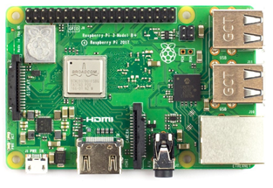
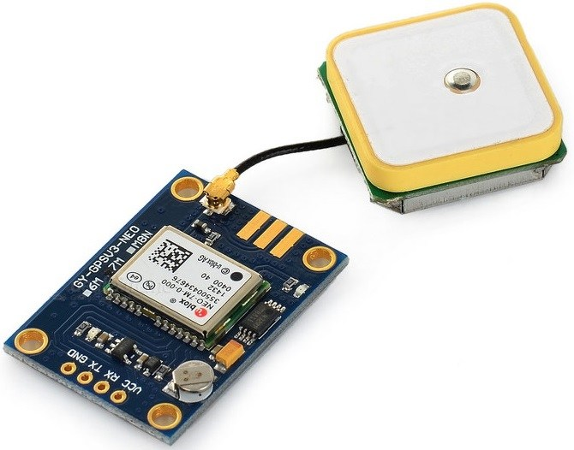
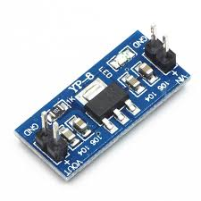
Circuit design
Necessary components
Raspberry Pi 3 of model B+
Ublox NEO-6m GPS Module
AMS1117 3.3V Regulator Module

Slide 5
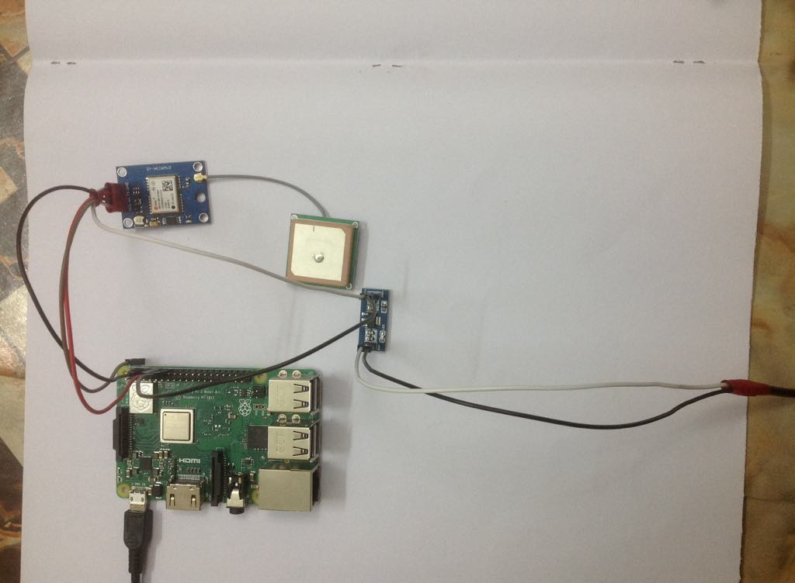
Circuit design

Slide 6
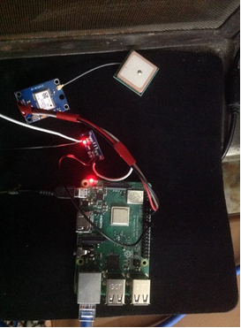
Circuit implementation

Slide 7
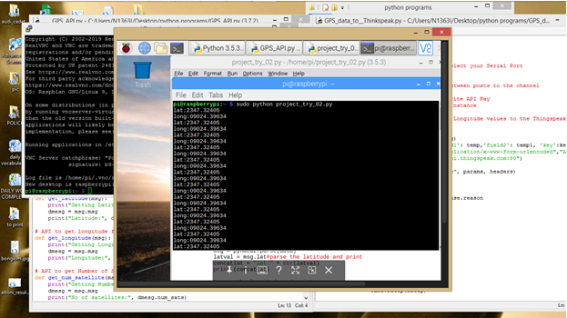
Output

Slide 8
Limitation
could detect present position
But failed to implemented the full task.
Tried to view the present position by calling the Google maps website via browser, but failed
Tried to store the data in a cloud server, then viewing the position in Google maps by accessing those data, but failed.

Slide 9
Thank you for your patience hearing

